Slide 1
ePortfolios – the past, the present and the future of skills development in higher education.
Dr Cressida Lyon (cl2255@bath.ac.uk)
University of Bath
Dept of Life Sciences

Slide 2
What is an ePortfolio?
Defined as a “purposeful aggregation of digital items [related to learning] which ‘presents’ a selected audience with evidence of a person’s learning and/or ability” (Sutherland and Powell, 2007).
Unique opportunity for:
Reflection and self-monitoring
Creative expression of understanding and success
Developing a supportive learning community
Logging and monitoring skills development during an undergraduate degree
Demonstrating graduate capabilities
(JISC, 2019)
Notes:
Sutherland and Powell, 2007. CETIS Portfolio [Online]. Available from: https://www.jiscmail.ac.uk/cgi-bin/WA-JISC.exe?A0=CETIS-PORTFOLIO.
JISC, 2019. How to enhance student learning, progression and employability with e-portfolios [Online]. Available from: https://www.jisc.ac.uk/guides/e-portfolios

Slide 3
What is included in the Bioscience Skills ePortfolio?
Setting goals
Logging and reflecting on feedback
Logging development of lab skills
Logging development of employability skills
Skills auditing – used to feed into goal setting
Uploading a CV

Slide 4
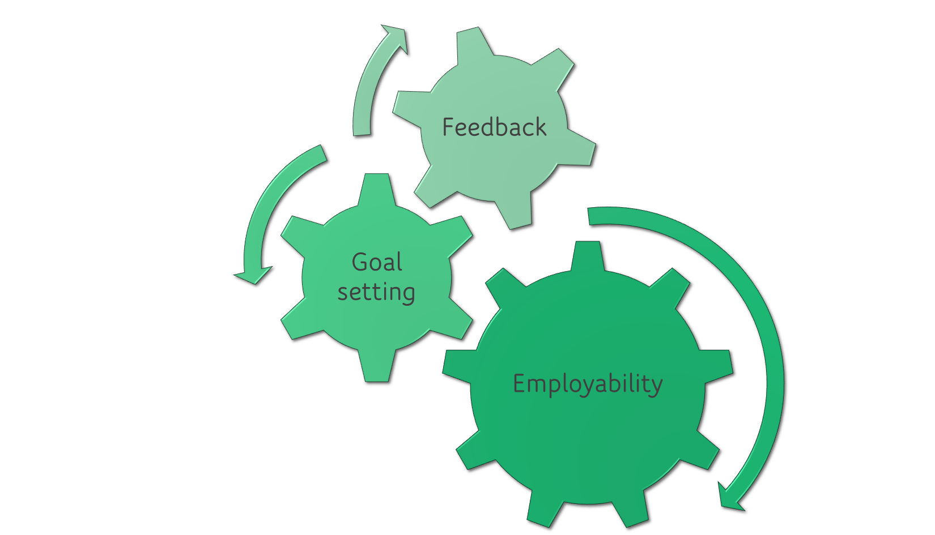
Skills ePortfolio

Slide 5
Why Feedback?
Feedback plays a key role in student learning and achievement
(e.g. Hattie and Timperley, 2007)
Students are less satisfied with (assessment and) feedback than any other aspect of higher education
(e.g. National Student Survey (NSS), Student Academic Experience Survey (SAES))
Based on Advance HE’s Developing Engagement with Feedback Toolkit

Slide 6
Why employability skills?
Graduate employment used as a metric for quality of university provision
Teaching Excellence Framework (TEF) emphasises importance of employability skills
CT: Embed employability skills into curriculum
→ students don’t always realise that they have these skills!
Based on ideas from JISC Guide: “How to enhance student learning, progression and employability with e-portfolios” (JISC, 2019)
And advice from Careers and Faculty of Science Placements Team

Slide 7
ePortfolio software
Onenote class notebook
mahara
Familiar interface (Microsoft)
Can use content library to share template pages
Can link to and embed documents into your notes
Can add content on nearly any device
Built in accessibility software
Associated Teams page for questions / links
Set up was complicated for lecturer (adding students to Teams)
Several students saved their ePortfolio in the wrong location
Interface is less familiar (takes time to learn)
Can create and share template pages
Used by Faculty Placements team (continuity)
Can’t link to or embed documents
Difficult to see what you’re typing in edit mode

Slide 8
Changes over the years…
2022-23
2023-24
ePortfolio was an add-on to the Year 1 “Practical and Academic Skills unit”
2% of unit
OneNote template run through Teams
Online training module (self-paced)
Not shared with tutors, marked by me
ePortfolio is fully embedded into the Year 1 “Core Skills in Bioscience” unit
0% must pass component of unit
Mahara
Several lectures / workshops
Shared with tutors prior to 1:1 tutorials and marked by tutors

Slide 9
ePortfolio – a tour
Biosciences Skills ePortfolio
If you would like to take a copy of the ePortfolio to look at, please follow these instructions:
Go to https://mahara.bath.ac.uk/ and log in with your normal University login
Navigate to Create > Pages and Collections, from the main menu.
Click the Copy button, and you will see a list of all the available pages and collections that can be copied.
Search for the Bioscience Skills ePortfolio, and click copy collection.
With a collection you need to confirm that the contents included are required by clicking through the ‘next buttons’ and then Saving.
Your copy will now appear in your personal list of Pages and Collections, ready to be edited.

Slide 10
Challenges
Engagement is often low until just before submission point (low stakes and therefore low priority)
Takes time to learn to use software
Students say that they don’t have much feedback to log
Slow if all using at the same time in class

Slide 11
Benefits
Promotes reflection – students can see their development / progress
Feedback is all in one place, so it’s easy to find and use to guide goal setting and for future assignments
Can export following graduation
For tutors: helps to provide more bespoke guidance for tutees and to write references

Slide 12
Recommendations
Don’t underestimate how long it will take to set up your ePortfolio
Once the template is shared, it cannot be changed, so make sure it’s right
Make sure it is organised and logical
Try not to be repetitive
Include links to relevant resources (but check that these still work each year)
Scaffold use of ePortfolio
Regular, in class workshops work best
Include an exemplar to show students what you expect (Example Bioscience Skills ePortfolio)

Slide 13
What next?
Faculty of Science ePortfolio group
Collaboration with ePortfolio fans in Chemistry, Pharmacy, Computer Science and Placements.
Analyse efficacy with a questionnaire at end of academic year
Please contact Kate Campbell (kjc47@bath.ac.uk) if you would like to join us!
Cross-institutional collaboration (Skills development in Biosciences)
Collaboration with Leicester, Bristol, Royal Holloway, Edinburgh, Kingston and Liverpool.
Case studies of staff reflections on use of ePortfolios
If you would like to use the Skills ePortfolio with your students, get in touch! cl2255@bath.ac.uk

