Slide 1
University of Bath
Vertically Integrated Projects
Welcome to our End-of-Semester VIP Poster and Presentation Event
^{12th} December 2023

Slide 2
Agenda
If anyone additional to the panel would like to ask a question please do so in the chat and we will try and get through as many as we can (time dependent).
16:30 | Welcome and Introductions
16:35 | VIP Posters and Questions
17:30 | Open discussion
17:40 | Thanks and Close
Notes:
Currently 8 projects (VR project formed into 2) have two new projects coming in Semester 2. Five projects have sent us posters for todays session, the others are not at a stage to report back at the moment.

Slide 3
INTERPROMOTING AN AGE﻿-FRIENDLY COMMUNITY
Simran Dua, Vishwesh Hampali, Abigail Hutzel, Rachel Lin, Vienne Hiu Yi Lin, Tey Milsome, Ambik Mitra, Sangjun Park, Girish Shouan, Kai Suzuki, Viktoria Todorova
Academic Lead: Prof Fiona Gillison
Notes:
First project to report back are Interpromoting An Age-Friendly community. Unfortunately members have been unable to attend so have left us with a few slides with progress. Can find out more information through latest blog https://blogs.bath.ac.uk/students/2023/11/10/age-friendly-vip-off-to-a-good-start/

Slide 4
Background
This VIP explores how the University can work with BANES and local older adults to help to create a more age-friendly and inclusive local environment.
It is the third year of the project running.
In the first year, we developed a survey to investigate what older adults were looking for to help them keep active in their local community.
In the second year, we organised a workshop to unpack the notion of ageism.
Photo taken during the Age-friendly workshop hosted in April 2023

Slide 5
Journey for this year’s VIP
From mid-Oct to mid-Nov
Planning to develop a programme/package for older adults to acquire some skills or knowledge together with younger adults
From mid-Nov to late Nov
Exploring volunteering opportunities for older adults and contribute ourselves as a VIP team
From late-Nov up till now
Photo taken in one of our VIP team meetings
Developing a session that involves both older and younger adults

Slide 6
Ideas of the session
Design of the session
Is it a lecture or practical workshop? Which disciplines would be able to accommodate?
Is their discipline accessible for a beginner? Could they provide a beginner session?
What would be their ideal scale of the lecture?
What is the time and length of the lecture?
Some practical considerations
Do they have a current network with older adults that may be interested?
Would the lecturer be able to teach in Dartmouth Avenue?
Would the lecturer have a student base that would be comfortable with an older adult audience?
Call for action
Would any of you be interested in teaching a one-off session?

Slide 7
Some next steps
Identify the topic of the session
Liaise with the lecturer who is interested in running a one-off session
Liaise with the network which has the older adult base
Apply for the VIP fund to support the logistics of the session (e.g. supporting older adults’ transport, getting some refreshments, booking a venue if there is a fee, and compensating staff’s time, etc.)
Develop some promotional strategies (e.g. contacting the VIP operational team, Anna Boneham, the Doctoral College, the lecturer’s networks, and our own networks)
Photo courtesy of the Centre for Ageing Better

Slide 8
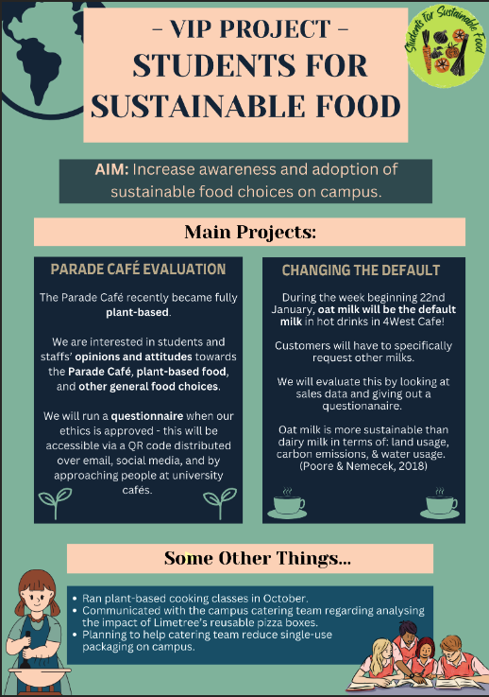
Notes:
VIP – Students for Sustainable food – We are joined by Mohini, Molly and Cece.

Slide 9
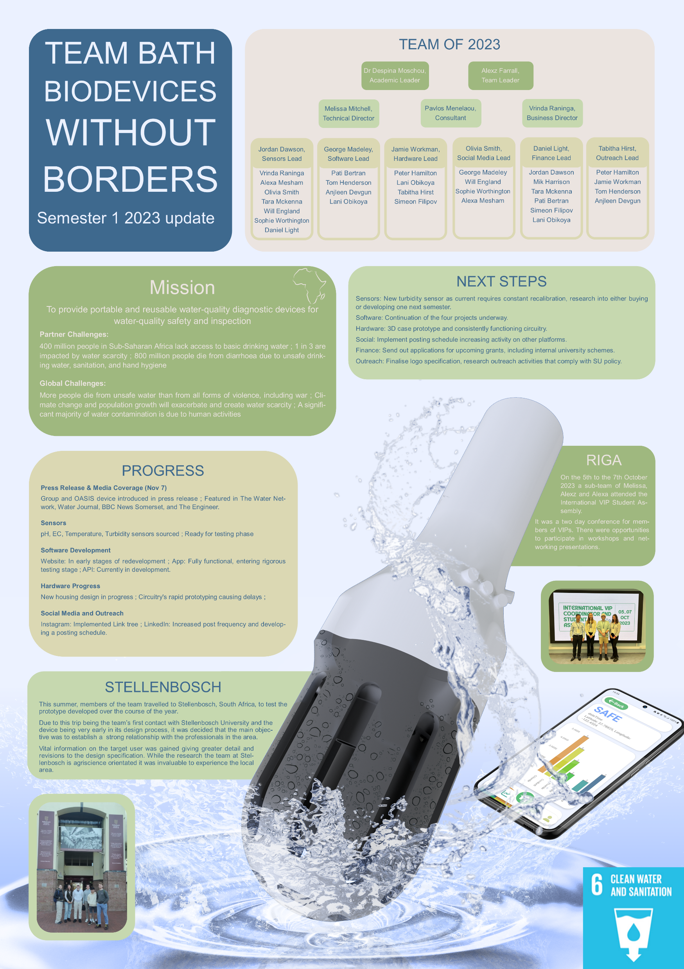
Notes:
Team Biodevices and have provided an audio update.

Slide 10
Notes:
Next 4 slides from VR team

Slide 14
Notes:
New VIP – Carers Centre. Some members have joined to talk about the project so far

Slide 15
Any other questions and open discussion
Thank you

