Slide 1
Get chatting
Before the workshop starts at 14:00, briefly introduce any previous experiences using Moodle quizzes
Contexts
Positives
Negatives
Mute Chat
This session is being recorded
Join TEL Community of Practice on Teams

Slide 2
Writing Effective Multiple Choice Questions
Bertie Squire & Josh Lim
Technology Enhanced Learning (TEL) team
Instructional Designers Team
tel@bath.ac.uk
teachinghub.bath.ac.uk

Slide 3
Today’s Session
At the end of this workshop you will learn:
The benefits of using MCQs both for both assessment & learning
How to write effective MCQs and pitfalls to avoid
How to construct, analyze and alter MCQs questions
The experiences, ideas and tips of others!
Recording session & will make slides (with links) available
Please get in touch afterwards tel@bath.ac.uk for any follow-up queries

Slide 4
Good quiz practices = link to learning
Empower students as self-regulated learners
Activity linked to learning objectives
For authors
Aims for learners
Impact through quality feedback = students act on feedback
Bitesize, low stakes → build motivation & self-esteem
Combine with other learning & teaching strategies
Planning | Learning objectives + cognitive skills Feedback → next steps, dialogue (e.g. tutorials, signposting, peer support, forums, problems classes)
Writing | See following guidance... Continuously
Managing | Build question bank over time Use data to inform Review questions
D. J. Nicol & D. Macfarlane‐Dick (2006)

Slide 5
Multiple Choice Questions
Advantages | Disadvantages
Different cognitive levels – fact recall/apply/evaluate | Finding “good” distractors hard Dominance of “recall” questions? “Higher order” vs. surface learning?
Wide coverage (less “sampling”) Fast feedback for students Easy to mark/score - can apply frequently Test analytics Different Uses (diagnostic, revision, Assessment for/as Learning) Many accessible features “built-in” | Difficult to “show working” Not well suited to maths Accuracy/suitability of assessment Engagement Students guessing Poor questions -> teachers work harder than students Fairness/accuracy

Slide 6
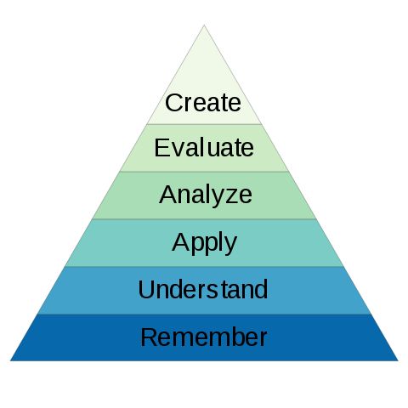
"Non-googleable MCQs"
Learning objectives + cognitive skill = MCQ test
Shift focus from recall to application
Understand (explain)
Apply (recall in context)
Analyse (explain in context)
Evaluate (best fit)
Use novel context
Use common mistakes/misconceptions as distractors
Multiple select (1 or 2 correct)*
Embrace open book exams…
Bloom’s Taxonomy by Nicoguaro is licensed under CC BY-SA

Slide 7
Constructing Effective Questions
Stem should be meaningful on its own
Don’t include irrelevant material
Use negative phrasing carefully
1
2
3
Writing Good Multiple Choice Test Questions – C. Brame (2013)

Slide 8
Constructing Effective Distractors
All the distractors should be:
Plausible
Clear and concise
Mutually exclusive
Homogenous in nature
Free from having clues to correct answer
The distractors aren’t functional if they are not plausible, as students who don’t understand the learning outcomes can still be rewarded. Use common student errors – these make the best distractors.
Students who know the correct answer should not have to worry about unclear and wordy answers and grasping what the answer is actually trying to say
A ‘trick’ question can sometimes lead to multiple answers being correct. Don’t have this ambiguity – make the answers mutually exclusive
This means the answers should all be in the same topic area. If one answer is focused on a different subject, it can lead students to the correct answer.
Savvy test takers can spot clues to correct answers such as differences in grammar, length, formatting, and language choices.
Writing Good Multiple Choice Test Questions – C. Brame (2013)

Slide 9
MCQ pitfalls to avoid
1) Select the correct option
MCQs are not…
Unlikely to be never ineffective
somewhat easy
Difficult to write, particularly to make them valid
All of the above
Cognitive load
Superfluous information (minimise reading)
Unfocused question stems (avoid lots of text or open ended) and blanks
Unimportant content/minutia – instead test main points
Negative stem or answer options (if necessary, be clear to emphasise the negative element “Which of this is NOT…”)
Confusingly ordered options (e.g. by size)
Wording Clues
Absolute terms (easy to dismiss) or vague terms (open to interpretation)
Grammatical clues (options deduced from stem)
Systematic
Unequal option length (correct answers often take more info)
“All/none of the above” option (e.g. trivial if 2+ match)
Logical clues (avoid mutually exclusive pair options, use multi select question instead)
Convergent option – correct answer has similarities with others
Webb et al., 2015
2) Select the errors demonstrated in question 1 from the list
(Answers: 2,4,6,7,8,9)

Slide 10
Limiting student collusion
Some strategies (with collusion disincentive in brackets), listed from more extrinsic to intrinsic student motivation:
Police/enforce/invigilate (the “stick” approach)
Restrict duration (limit opportunities)
Don’t have marks associated with assessment – separate formative/summative assessment (remove incentive)
Question randomisation: mix up the order in the test or set question variants (remove ease of colluding)
Use confidence based marking to score students and encourage students to reflect (dissuade blind copying)
Follow up assessment e.g. create consequences: pick students to explain answer in tutorial, random to provide written worked solution justification to accompany course material (create incentives to be honest & seek help)
Use variable/context randomisation – this could be used to promote peer collaboration/discussion (avoid simple copying)
Educate and promote ethos, purpose of assessment– make it clear to students (from all backgrounds) what collusion is, aims of assessment and disadvantages to learning (educate learners)
Broaden assessment aims to allow collaboration and group/peer instruction (remove incentive)
High intrinsic value of the activity and feedback (make motivation to collude counterproductive)
Disclaimers!
This list isn’t exhaustive and the exact and extent of the solution(s) will be context specific (the above is not a hierarchy), but may be useful to consider!
Many of these issues are not unique to e-Quizzes, but digitising does give some solutions!

Slide 11
Workshop
Activity

Slide 12
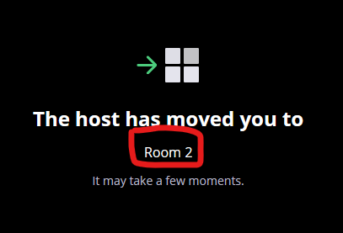
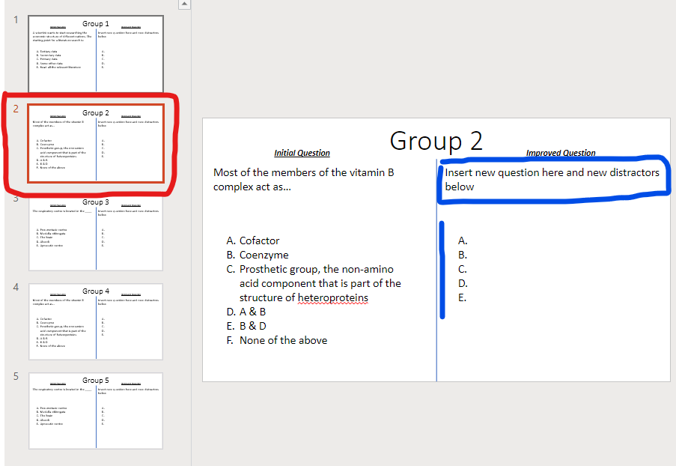
Improve an MCQ question
Open WORKSHOP ACTIVITY Powerpoint
Write an improved question
Improve question stem?
Improve distractors?
Shift question emphasis?
One person per group > Feedback on what you did
Groups: 3-4
10 mins
Feel free to add text box comments to your own slides!

Slide 13
MCQ Experiences Dicussion
Think about past experiences both taking and delivering MCQs
What went well?
Do you refine and revisit questions?
Did you vary question types?
Were then un-googleable?
Any tips which you found helped?
Did it help students’ understanding?

Slide 14
Key points
Start with learning objectives & the focus for the quiz
Write effective questions!
Review and revisit your question bank

Slide 15
References and further reading
Quick read: Writing Good Multiple Choice Test Questions – C. Brame (2013)
Good summary with links to literature: The Importance of Writing Effective Distractors – C Malamed (2020)
Nicol, D. J & Macfarlane‐Dick, D., 2006. Formative assessment and self‐regulated learning: a model & 7 principles of good feedback practice, Studies in Higher Education 31(2) p199
Carneson J, Delpierre G, Masters K., 2016. Handbook: Designing and Managing Multiple Choice Questions (2nd Ed) [online only]
Gierl, M et al., 2017. Developing, Analyzing, and Using Distractors for Multiple-Choice Tests in Education: A Comprehensive Review. Review of Educational Research, 87: 6, pp. 1082 –1116.
Rodriguez, M. (2005). Three Options Are Optimal for Multiple‐Choice Items: A Meta‐Analysis of 80 Years of Research, Educational Measurement: Issues and Practice, 24:2.
Haladyna, T.M. et al., 2002. A Review of Multiple-Choice Item-Writing Guidelines for Classroom Assessment. Applied Measurement in Education 15(3) p309
Webb, E et al., 2015. Does Educator Training or Experience Affect the Quality of Multiple-Choice Questions? Academic Radiology 22(10) pp. 1317
McCoubrie, P. 2004. Improving the fairness of multiple-choice questions: a literature review. Medical Teacher 26(8) p709
Moodle Quiz Settings and Setup FAQ on the Teaching Hub

Slide 16
How to get engagement in formative assessment and feedback?
Link to general engagement strategies: employability & real world context, develop skills, student voice/ownership, peer assisted, student generated feedback, stakeholder engagement, social learning, diversify/integrate with other teaching activities, educate students on benefits, combine with summative, students reflect on learning, reflect & adapt teaching strategy ….
Strategies specific to online quizzes:
Vary quiz behaviour
low stakes & “fast fail” approach: multiple attempts (with penalties), instant feedback
Use social aspects as a lever with technology
Variable/context randomisation to promote peer collaboration
Social learning – forums, MS Teams etc to support discussion
Student generated feedback – students as assessors (e.g. Moodle workshop)
Vary feedback delivery
instant timely feedback, selective feedback (reveal feedback only, hide score etc), blended feedback (in tutorial)
Stress High intrinsic value of the activity and feedback
Assess aspects that would be take to long to assess traditionally (e.g. wide coverage, calculations with real data set etc).
Timely feedback can be more effective
Create quality bespoke feedback (this becomes scalable)

Slide 17
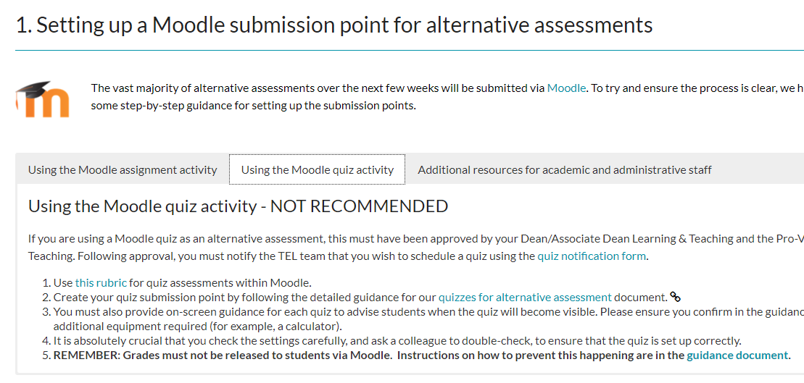
Before you start
Guidelines for setting up quizzes have been created for the current assessment period
Read the guidance (even if familiar with Moodle quizzes)
Dos and Don'ts of online assessments PDF
Quiz settings Setup and FAQ
Creating a Quiz Assessment in Moodle as an alternative assessment (PDF)
Some settings will be different from the ones you normally use for formative quizzes e.g. visibility of feedback
*

Slide 18
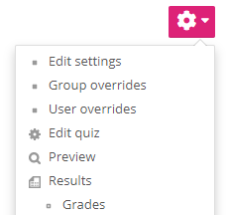
Moodle quiz settings
Step by step instructions with screenshots:
Creating a Quiz Assessment in Moodle as an alternative assessment
(PDF)
Quiz settings (rubric, availability, timing etc)
Extra time
Edit question set
View, amend, export grades
Quiz settings Setup and FAQ

Slide 19
Setting up the Moodle quiz
Key things to remember:
Read the guidance and follow carefully
Use default settings unless otherwise specified
Name your quiz clearly
Give clear instructions to students (University Rubric, Academic Integrity Declaration)
Consider using grade transfer
Adjust availability or duration for students with DAPs
Test: Preview your quiz, check availability

