Slide 1
Title
Curriculum Transformation Phase 1
STAKEHOLDER HEAT MAP

Slide 2
Mapping stakeholder relationships
At a department level, write down the top 15 (max) most important stakeholders with which you engage.
Organise the post-its into a circle around the name of your department.

Slide 3
Mapping the stakeholders
To create the map the following should be considered:
The type of transaction that currently occurs with the stakeholders as part of that relationship
The current frequency of the relationship (i.e. how often that stakeholder is engaged)
The current direction of the relationship and whether it is equal on both sides

Slide 4
Key to mapping
Type of transaction | Relationship frequency, including direction
S = strategic | Distant/minimal (monthly)
O = day-to-day operations
 | Frequent (weekly)
T = technical
C = contractual
 | Continuous (daily)
F= functional
R= reporting
V = service

Slide 5
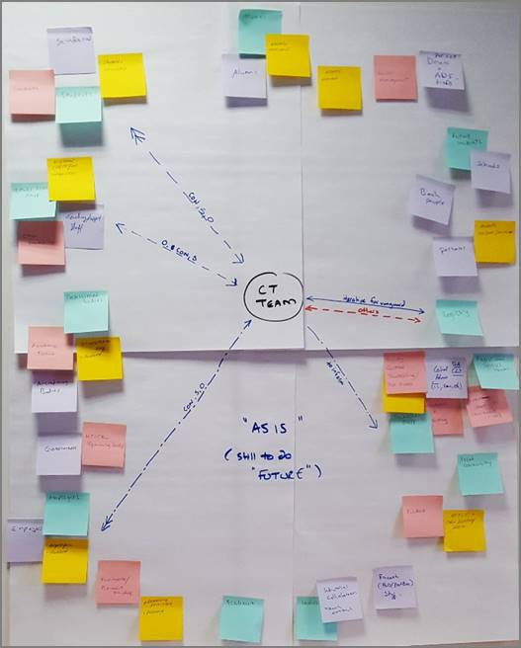
Might end up looking something like this…
You can use the stakeholder mapping exercise (see powerpoint) to identify your key stakeholders, your relationships with them, and to help prioritise your engagement activity (approx. 20-30 mins). An exemplar external stakeholder survey template is provided for reference.

Slide 6
You now know…
Your key stakeholders
The type of relationship you have with those stakeholders
The frequency of the relationships
The balance of those relationships

