Slide 1
Cracking the code of marking criteria & mark schemes

Slide 2
Shared language:
Marking criteria= course wide
Mark scheme= specific to assessment task
Marking rubrics= rules/ guidelines and pre-defined mark allocation

Slide 3
CILOs
Clarity around criteria verbs
Clarity around criteria levels
Contextualising marking criteria

Slide 4
Unit and assessment design
Unit development
Good practice
Diversity
Consistency
Creativity
Communication
Freedom
Efficiency
What should we standardise?
Complete chaos
Complete dictatorship

Slide 5
Problem statement
Assessment takes too much lecturer time, and yet common complaints:
Lack of consistency and clarity in marking criteria
Unsatisfactory level of feedback
NSS scores are low
Risk factors:
Pre-CT and CT running at the same time
Increasing numbers
Diversity of programmes / units / students
CT PGT – 50% pass mark
ChatGPT et al requiring different assessment practice
Short term
Support units in need through coaching/resourcing
Long term
Assessment that is efficient, consistent, and clear, through common language

Slide 6
Criteria
Two components
Verb… | …noun
Recite… | …the four P’s.
Use… | …NPV.
Compare… | …diesel and unleaded.
Analyse… | …the HR policy.
Critique… | …Porter’s ideas.
Build… | …a model of sustainability.
Cognitive process
Knowledge
Each unit spends considerable time explaining this.
We are good at this

Slide 7
Designing assessment criteria:
Replace | With | Or (subject specific descriptors) | Useful feedback statements
Excellent | Fully developed, Developed and consistent use of… Range and depth Detailed Explicit and relevant throughout
Good | Significant, Developed in places/ but not consistent Explicit use of… Range or depth Substantial Explicit Largely relevant
Satisfactory | Implicit, Some Clear Reasonable Relevant Accurate, but incomplete Evidence of
Problematic | Limited, An attempt Stated Drifts into…
Poor | Very limited Significant errors/ omissions Little/ no understanding of the task/ material Insubstantial
CILOs:

Slide 8
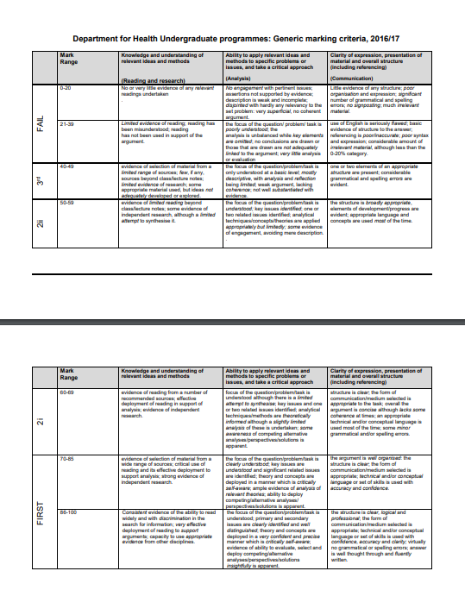

Slide 9
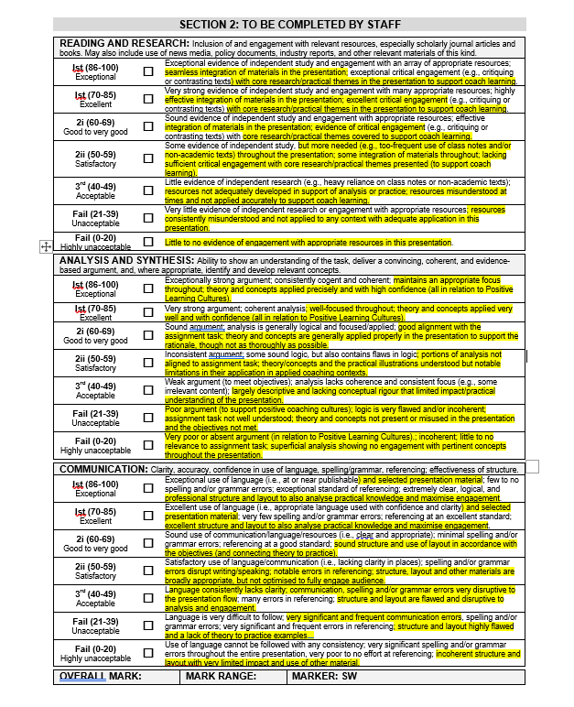

Slide 10
Formative assessment
Stop/start/Continue, SSLC, comparisons between units e.g., Online Unit Evaluations (OUE’s)
NSS [Assessment and Feedback]
(2019/2020) 82.03/83.33% (Bath University - 66.30%)
(2020/2021) 88.64/82.73% (Bath University - 60.91%)
(2021/2022) 93.42% (Bath University 61.82%) also include 100% re ‘criteria for marking’

Slide 11
Application to different assessment types:
Essay
Report
Visual/audio report
Dissertation
Portfolio
Oral assessment/ presentation
Viva voce
Set exercises
Reflective assessment

Slide 12
Assessment and Feedback:
Marking criteria as a series of
lenses for marking
knowledge
Application
Presentation
Notes:
https://impactarena.com/2019/03/02/vad-senaste-forskningen-sager-om-konstruktiv-feedback/

Slide 13
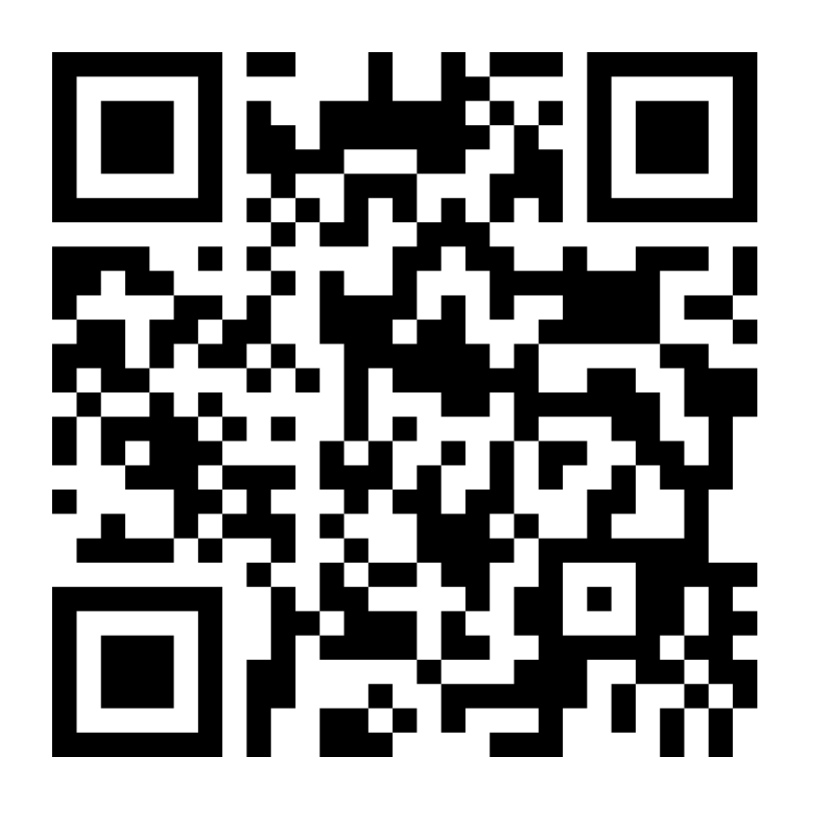
We want your feedback
www.menti.com
Enter Code: 1498 8888

