Slide 1

Message for staff
These slides have been created to support academics in providing guidance to their students. The slides have intentionally been created on a blank background so that staff may easily copy the key information onto their lecture slides / activity instruction sheets.
As always, we recommend staff tailor the information for their students and activity as the information provided will be general.

Slide 2
What is the Moodle Group Peer Evaluation activity?
The Group Peer Evaluation activity allows students to rate one another after working on a group assignment. Teaching staff may ask students to rate each other on criterion such as contribution to a group task.
Final assessment marks for individuals may be adjusted based on the assessment students receive from the peers in their group.
Any marks and comments will not be visible to other students in your group.
Comments are optional and can be viewed by teachers on the course.

Slide 3
Preparing for your Group Peer Evaluation activity
Ensure you are in a group.
Read the instructions and guidelines for the Peer Evaluation activity. Ask questions or seek clarification on any point you are unsure about.
Complete your evaluation on time, there may be penalties for non-participation.

Slide 4
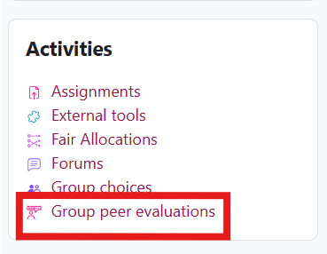
Submitting your Group Peer Evaluation
You can find the Group Peer Evaluations in the Activities block of your Moodle space, or access it via this link:
This activity can be completed before or after the submission of your group assignment in Moodle. Make sure you meet the deadlines provided.
Your final grade for the assignment is based on the assignment score and an aggregated peer evaluation weighting.

Slide 5
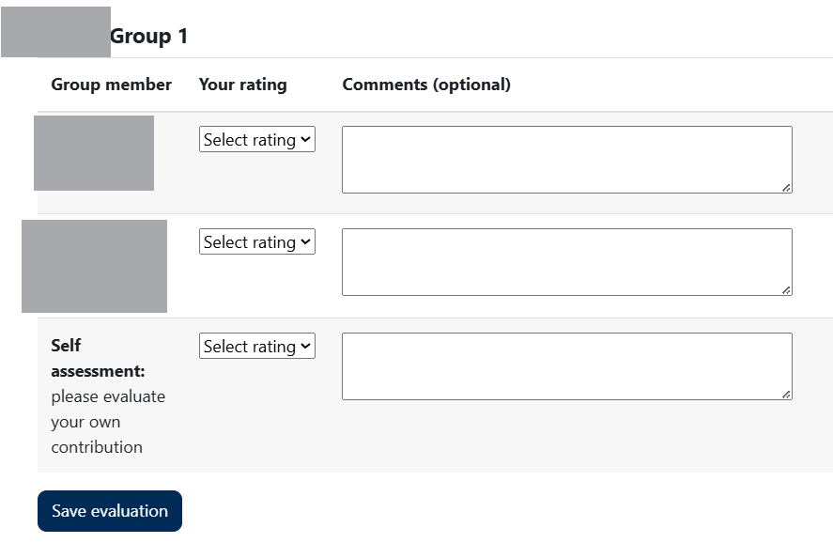
Submitting your Group Peer Evaluation
Make sure you read the Peer assessment criteria and use them to rate your peers’ contributions to the group task.
Fill in your ratings and comments, and make sure that you choose Save evaluation before leaving the page.

Slide 6
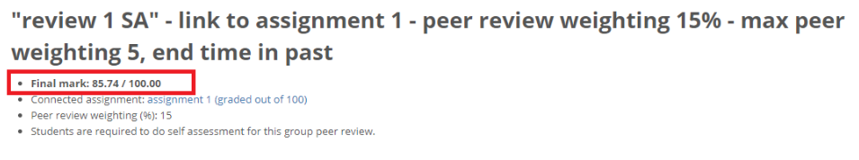
How to view your marks
Your unit convenor will tell you when they have reviewed and saved the final marks and made them visible.
To view your individual final mark, go back into the Peer Evaluation Activity.
The final mark is made up of the group assignment mark scaled by your aggregate peer mark and a peer assessment weighting, which has been reviewed by your unit convenor.

Slide 7
Further support for students:
For students with any further questions or require additional support please contact your unit convenor or teaching team.

