Slide 1





Moodle Groups & Groupings
Workshop facilitators:
Please visit Learning & Teaching Hub Past Events for a recording.
Lynn Cheong-White
Rachel Applegate
tel@bath.ac.uk
teachinghub.bath.ac.uk

Slide 2
Session Overview
What are groups and groupings?
Setting up Groups
Setting up Groupings
Using groups and groupings with an assignment
Setting up restrictions with groups and groupings
Using groups and groupings with forums

Slide 3




What are Groups & Groupings? Definition
Groups and Groupings are used to manage student cohorts, facilitate group work and/or restrict access to activities, resources or topics within a Moodle space.
Notes:
In a SAMIS Mapped Moodle space Groups and groupings will exist.

Slide 4
What are Groups & Groupings? Infographic
Grouping
Group 1
Group 1
Group 2
Cohort
Group 2
Notes:
Group and grouping workflow:
Put your students into groups.
Put your groups into a grouping.
Groupings may be new to some. With the changes in Moodle 4.3 you will now need to put your groups into a grouping.

Slide 5
What are Groups & Groupings? SAMIS Group
SAMIS Group: LC12345 2024/5 S1 cohort
Notes:
New with Moodle 4.3.
In a SAMIS Mapped Moodle space Groups and groupings will exist.
In this example imagine these 4 figures represent your cohort. When they are brought into the space from SAMIS they will automatically be put into a group.

Slide 6
What are Groups & Groupings?
Group 1
Group 2
Notes:
You can also create your own groups, for example for a group assignment.
In this example the 4 students have been put in pairs.

Slide 7
What are Groups & Groupings?
2 groupings
Assignment Grouping
Group 1
Group 1
Group 2
Group 2
SAMIS Grouping
LC12345 2024/5 S1 cohort
LC12345 2024/5 S1 cohort
LC12345 2024/5 S1 cohort
LC12345 2024/5 S1 cohort
Notes:
Yours students now belong in two different groups. When you try to do any group activity Moodle will not know which set of groups you want to use. This is when you use groupings.

Slide 8
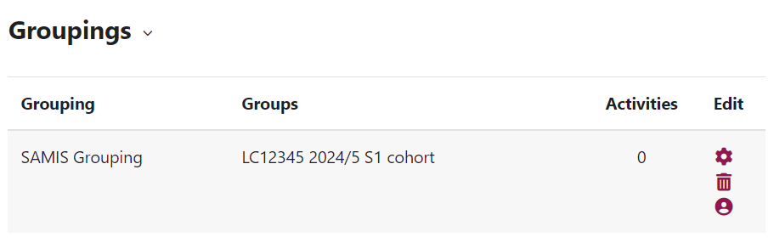
What are Groups & Groupings? Screenshot 1
Moodle automatically puts its SAMIS cohort group into a grouping called “SAMIS Grouping”.
Notes:
Just as Moodle automatically puts SAMIS cohorts into groups they also put the SAMIS cohort groups into a grouping.

Slide 9
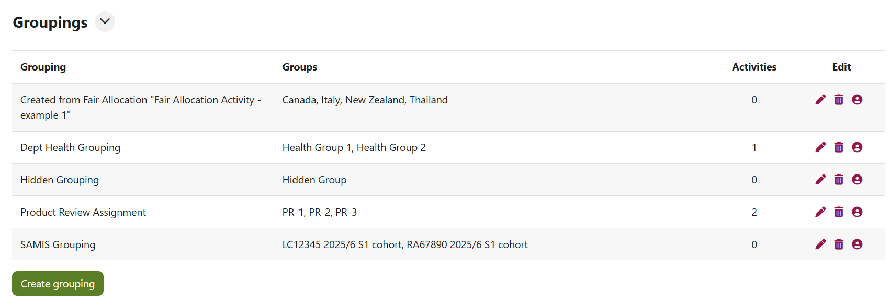
What are Groups & Groupings? Screenshot 2
Notes:
Another examples of groupings with groups.

Slide 10
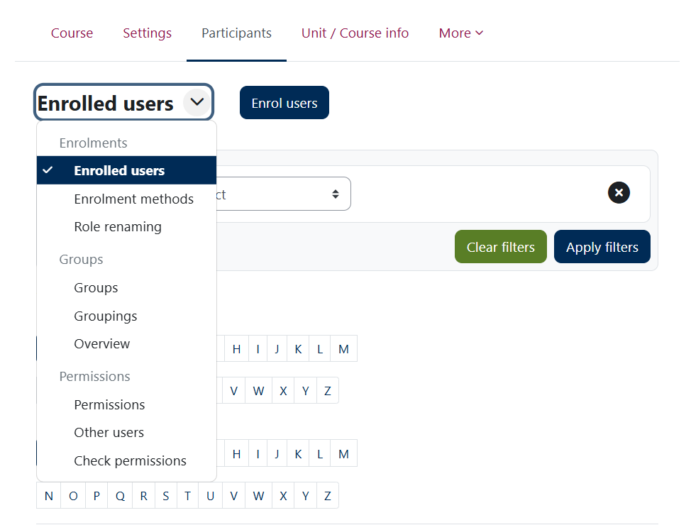
Navigating Groups & Groupings
1
Group – Section where you can create new groups, view group membership, edit & delete existing groups
Grouping – Section where you can create new groupings, view grouping membership, edit & delete existing groupings
Overview – Section that displays an overview of groupings, groups within them and membership
2

Slide 11

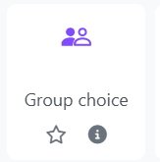
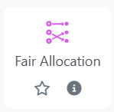
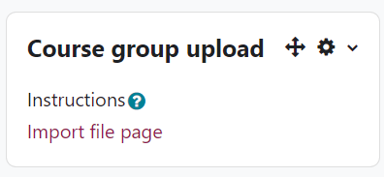
Creating Groups
Teacher created groups
Student created groups
Notes:
Manually creating groups

Slide 12

Course Group Upload
Allows you to create groups by uploading a .csv file.
Can create the groups and groupings in Moodle.
Participants must already exist on the Moodle space.
Adding a new .csv will create new groups not update existing ones.
How to use Course Group Upload.
Notes:
Quickest way to create groups if you already know which students need to be in which group.

Slide 13
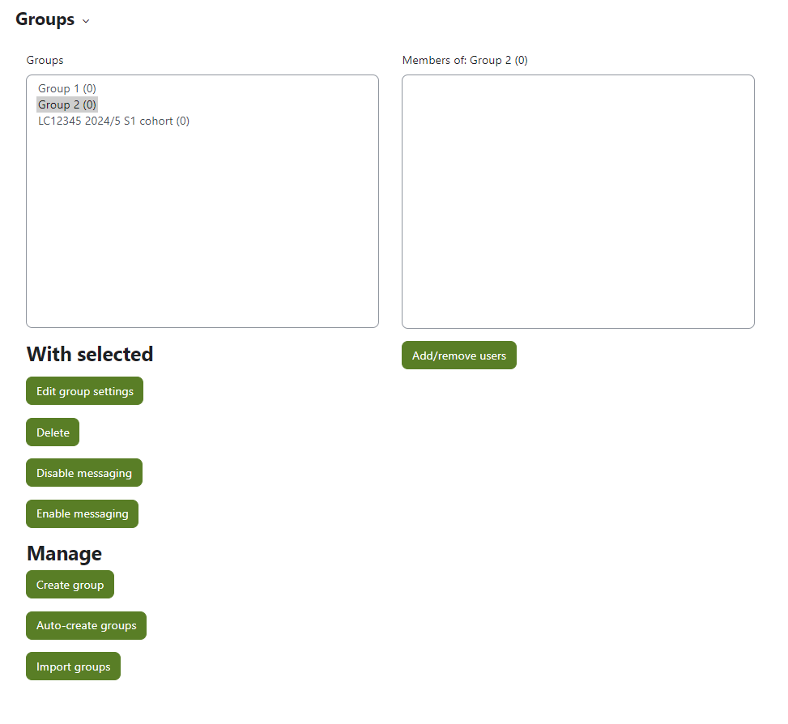
Create Groups (manually)
Can create new groups.
Can edit existing groups.
Can change membership of groups.
How to create groups manually.

Slide 14
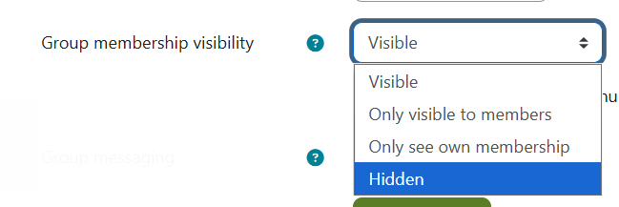
Hidden Groups
*NEW* You can now create groups where membership is not visible to student participants
Notes:
These are useful if you need to have students in groups for extensions or re-assessment point submissions.

Slide 15
Group Choice
Teacher must create the empty groups before setting up the activity.
Students select the group they want to join.
Moodle allocates students into the groups.
How to set-up Group Choice.
Notes:
Can’t use without creating groups first.
Explain them and student view screen shot, link to hub guidance

Slide 16
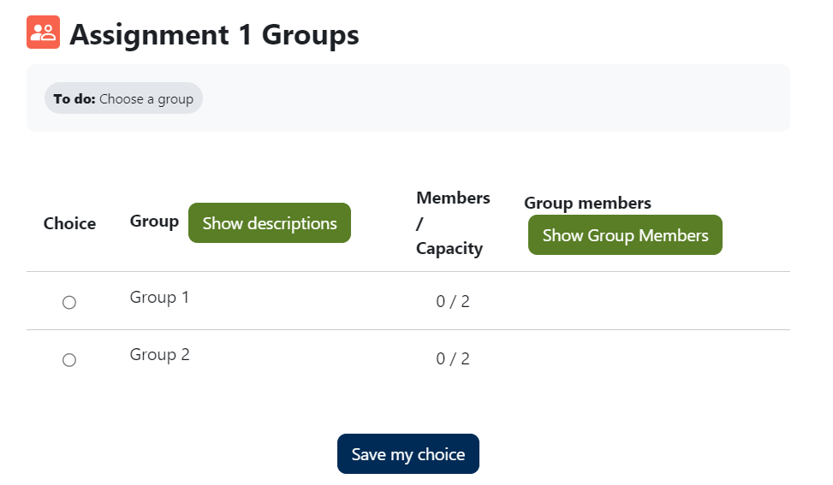
Group Choice – Student View
How to set-up Group Choice.
Student view.
Notes:
Can’t use without creating groups first.
Explain them and student view screen shot, link to hub guidance

Slide 17
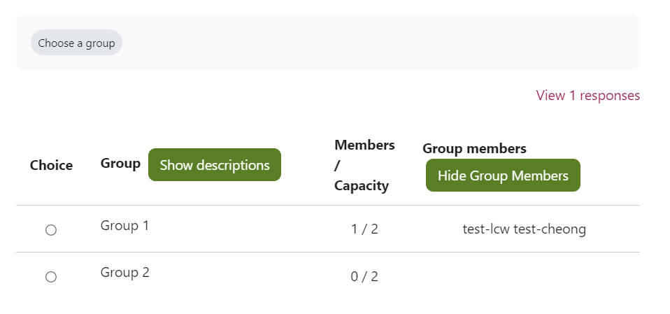
Group Choice – Teacher View
How to set-up Group Choice.
Teacher view.
Notes:
Can’t use without creating groups first.
Explain them and student view screen shot, link to hub guidance

Slide 18
Fair Allocation
Allocates students to groups based on their preferences.
Students can rate options.
Allocation is automatic, but staff can make manual changes.
Groups cannot be created before setting up this activity.
How to set-up Fair Allocation.

Slide 19
Fair Allocation 2
Steps:
Set-up activity.
Edit choices – set up groups. You cannot use pre-existing groups.
Allow students to rate choices.
Run Allocation Algorithm to assign students to groups.
Review allocation in “Show Allocation Overview”.
Create groups from allocation and publish the groups.
Students are now in groups.
How to set-up Fair Allocation.
Notes:
Cannot use pre-created groups. If groups have the same name it will create a new group.

Slide 20
Creating a Grouping
Notes:
Groupings can be created when doing the group upload and they can be created manually.

Slide 21



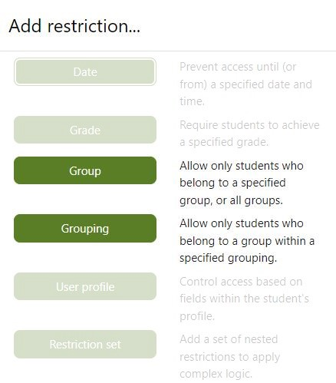
Using groups & groupings in Moodle Activities
Using groups and groupings in an assignment
  Group Peer Evaluation
Setting up restrictions with groups
Using groups with forums

Slide 22
Demonstrations – your choice
DEMO 1: Using groups and groupings in an assignment
DEMO 2: Setting up restrictions with groups
Signposting: Using groups with forums
Focus today
Brief spotlight
Further guidance

Slide 23

Groups and Groupings in Moodle Assignment
Grouping
Group 1
Teacher
Adds marks and / or feedback
Apply to entire Group or individuals*
Group 2
How to create a group assignment
Marking a group assignment
Notes:
LIVE DEMO
Go to Groups overview – show Product Review Assignment Groups (3 groups)
Show how you would add an assignment
Go to assignment already created (Settings)
Highlight Group Submission settings
Students submit in groups: Yes
Grouping for student groups: selected
Save and Display
Grading summary screen – how many groups are you expecting?
Note there are 4 Groups in the summary!
Note warning re: Default groups
View Submissions tab – check all students are in groups / not in Default group
Note one student (test lcw) is not in a group so has gone in to Default group
Go to Participants – add student to group (PR-3)
Go back to assignment – Note there are now 3 Groups (as expected) / warning message has gone
Go back to Submissions tab – Note all students are now in groups
Demo 2: group assignment submission point
Submission by students in one group
A single student uploads the file and it populates for all students in the group
Note submission timestamp and file name
To mark, go to Grade – add grade, workflow status, feedback comment
Scroll to bottom of grading panel: Default = Apply Grades and feedback to all students Yes
NOTE: Default setting for 'Apply feedback to Group' - highlight this reverts to Default YES each time you save
Can use Grading worksheet for Group submission with individual marks

Slide 24

Checking your Group assignment (1)
Check your assignment set-up on creation. Once students submit, you can't change the settings!
1. In the Grading Summary, check the number of groups
2. Check for any Warning messages (red banner)
3. In the Submissions tab, check that all students are listed in a Group
4. Use the Groups Overview tab to make sure all students are in a Group

Slide 25
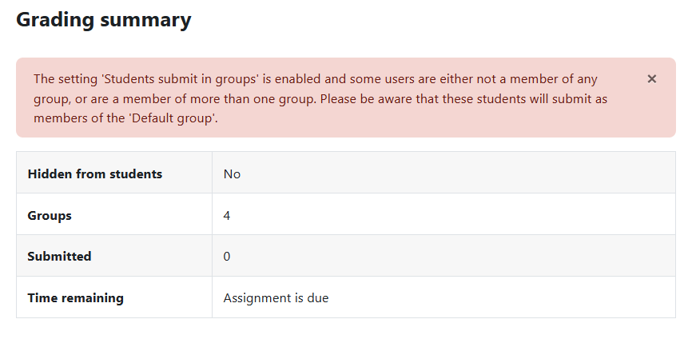
Checking your Group assignment (2)

Slide 26
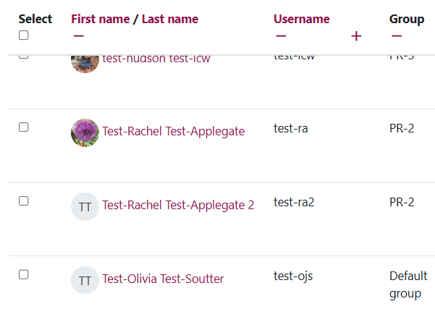
Checking your Group assignment (3)

Slide 27
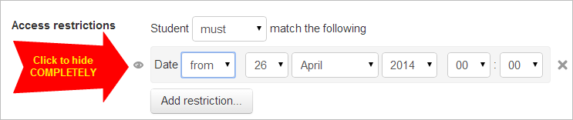
Restricting access by groups
Restrict access to make Resources or Activities visible to a Group (or Grouping)
  For multiple unit cohorts in one Moodle space
  For restricting access to assignments
Can apply to whole Topics, or individual activity or resource
Option to Hide completely from students not in a group
Using restrict access
Notes:
Live demo
Go to Course Page
Turn Editing on
Go to Edit Topic (Topic 2)
Restrict Access
Group
Select Cohort Group
Show difference between Displayed or Hidden – choose Hide completely
Save and display
Go to Course page and show condition for Teacher

Slide 28
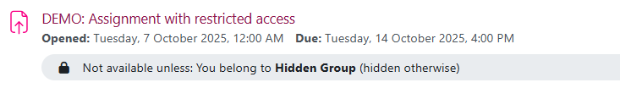
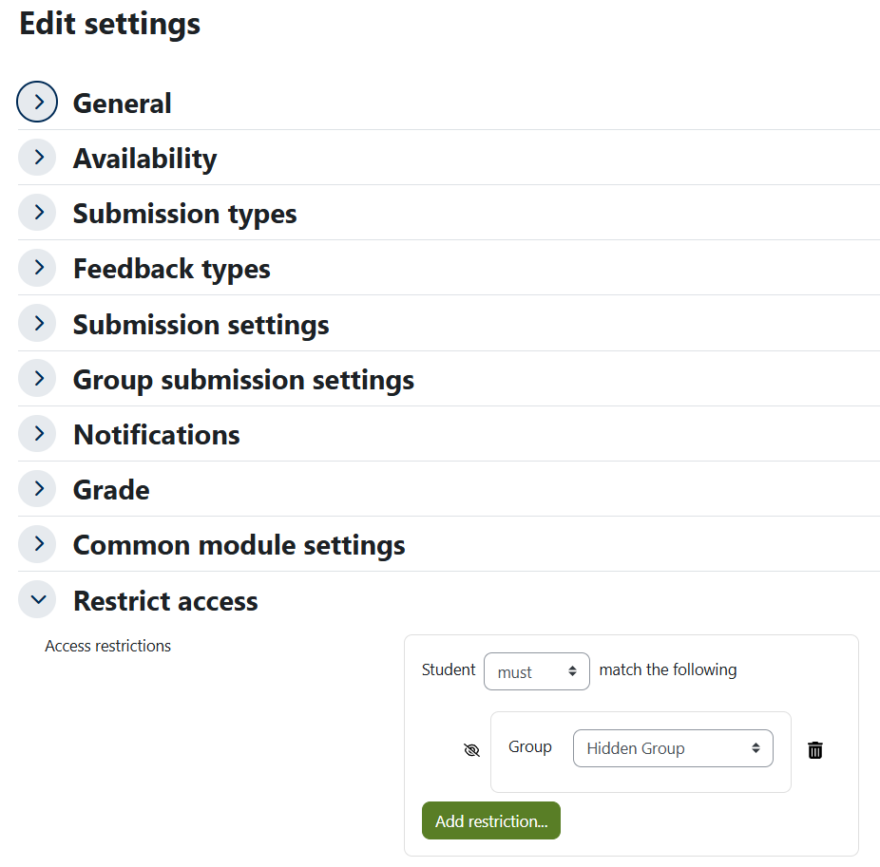
Example: Restricted access for reassessment
Using Hidden Group, restriction automatically set to Hide entirely
Students not in the Group won't see the activity
Digital assessment workflow - reassessment

Slide 29
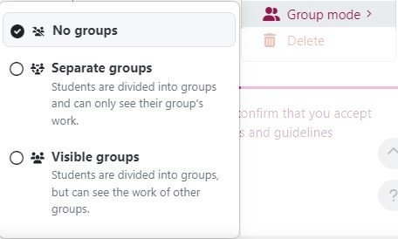
Groups and Groupings in forums (1)
Separate groups
Group 1
Group 2
Visible groups
Group 1
Group 2

Slide 30
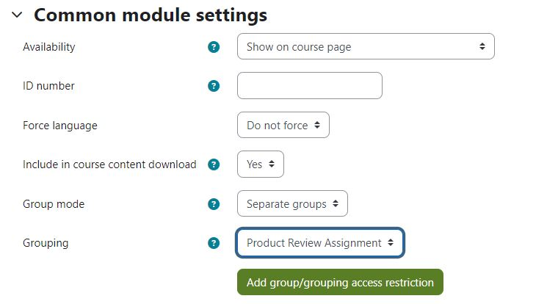
Groups and Groupings in forums (2)
Using groups with forums
Notes:
In the forum settings, set the Group mode to Separate groups or Visible groups
Select your Grouping to link your forum to a set of groups

Slide 31
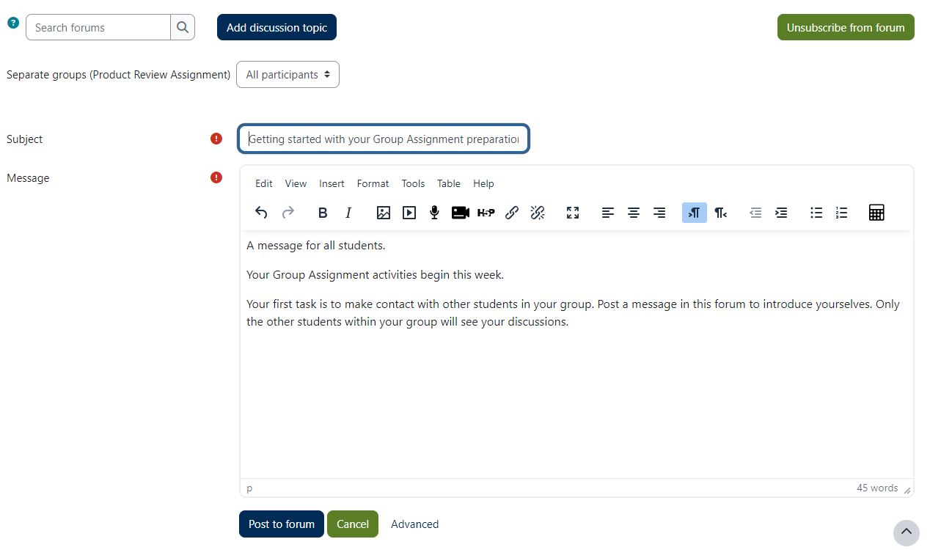
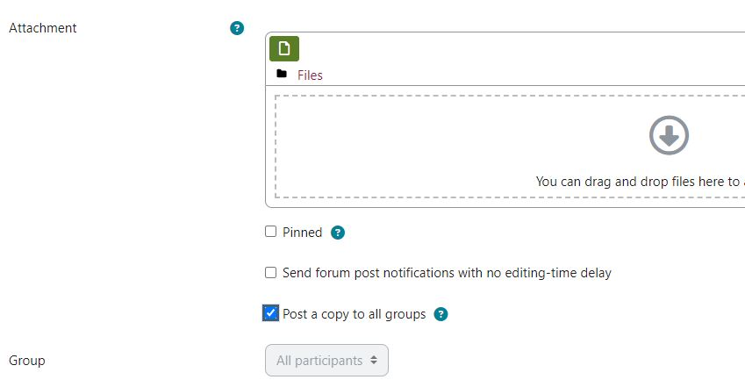
Groups and Groupings in forums (3)
Using groups with forums
Teacher view.
Notes:
Select All participants or a group to post to students
Under Advanced settings you can Post a copy to all groups
All students can see your post, but they can only reply within their groups

Slide 32
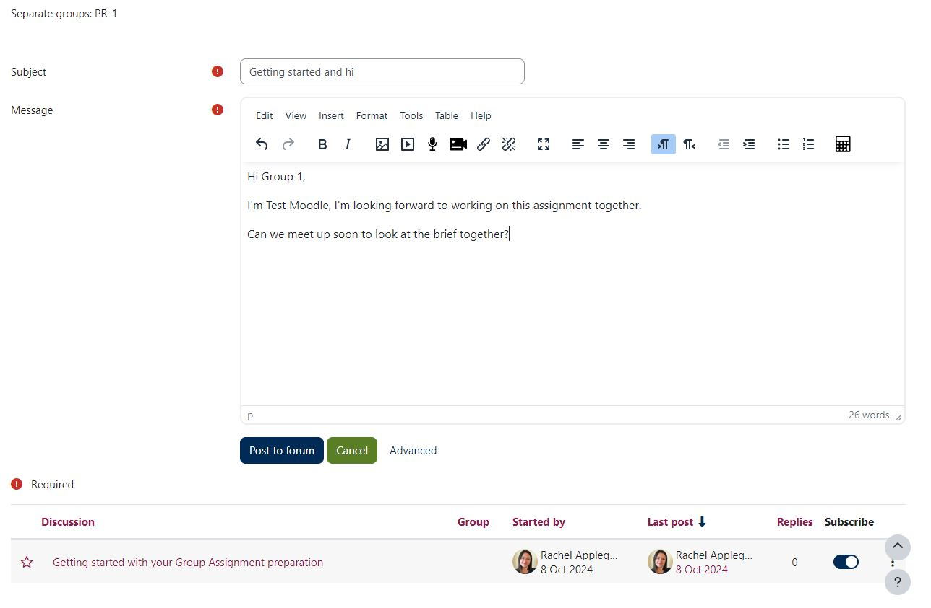
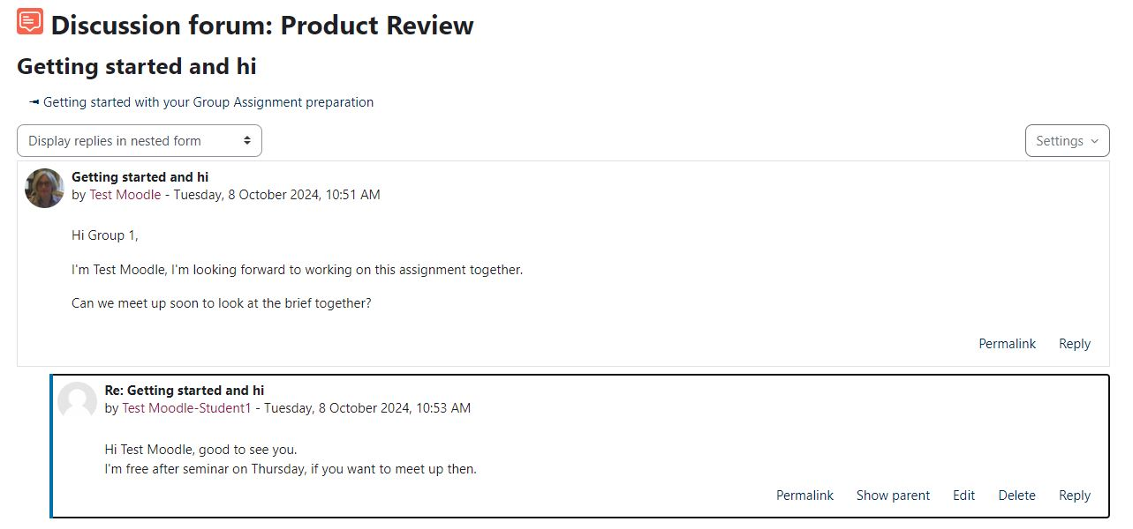
Groups and Groupings in forums (4)
Using groups with forums
Student view.
Notes:
Students can view posts made to All participants (by a Teacher)
Students can only make a post within their group
Students can reply to discussions within their groups

Slide 33
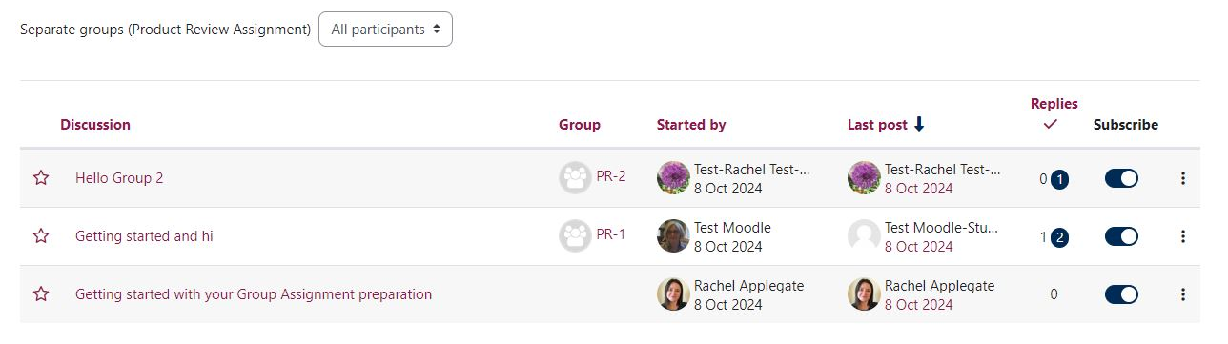
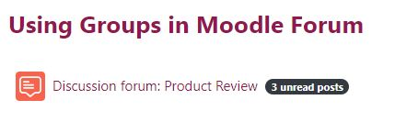

Groups and Groupings in forums (5)
Using groups with forums
Teacher view.
Notes:
Teacher can view discussions by all groups
Teacher can filter by group
Unread posts are flagged (on Moodle page and within forum)

Slide 34

Groups & Groupings top tips - Extensions
Troubleshooting Groups & Groupings:
I have used groups to distinguish which students have an extension, but I don’t want other students to see these groups, how do I hide them?
Make sure you have created a “hidden” group. Please note once a group has members you cannot change the visibility so you may have to create a new group.

Slide 35

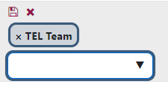
Groups & Groupings top tips – Move students between groups
Troubleshooting Groups & Groupings:
One of my students is in the wrong group, how do I move them?
The easiest way to move one student in the wrong group is to find the student in the Participants page next to the group they are enrolled in, select the pencil icon.
Next, click the x next to the group you want to remove them from and from the dropdown select the appropriate group for that student.

Slide 36
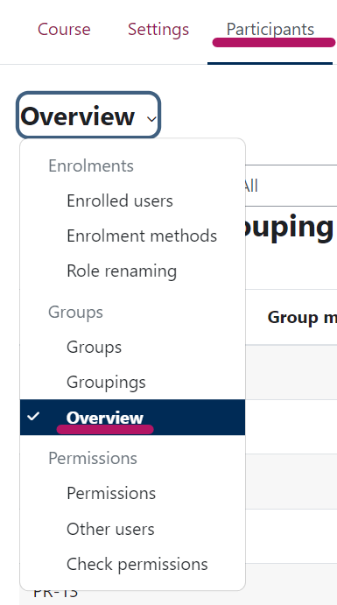
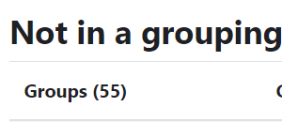
Groups & Groupings top tips - Grouping
Troubleshooting Groups & Groupings:
How do I know if my groups are in groupings?
Under Participants go to “Overview”.
At the bottom there will be a category “Not in a grouping”, which will list any groups not in a grouping.

Slide 37
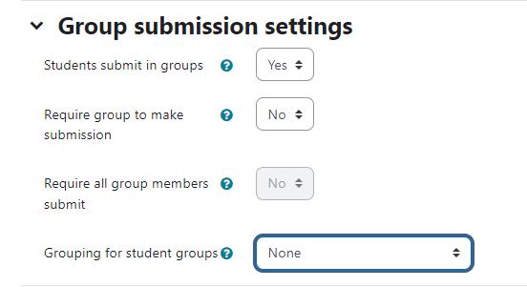
Groups & Groupings top tips – Group assignments
Troubleshooting Groups & Groupings:
Students belong to more than one group; how do I get Moodle assignment to know which groups I want to mark?
Remember to put your groups into groupings. When setting up your assignment, as well as setting up “students submit in groups”, select the appropriate “Grouping for student groups”.

Slide 38
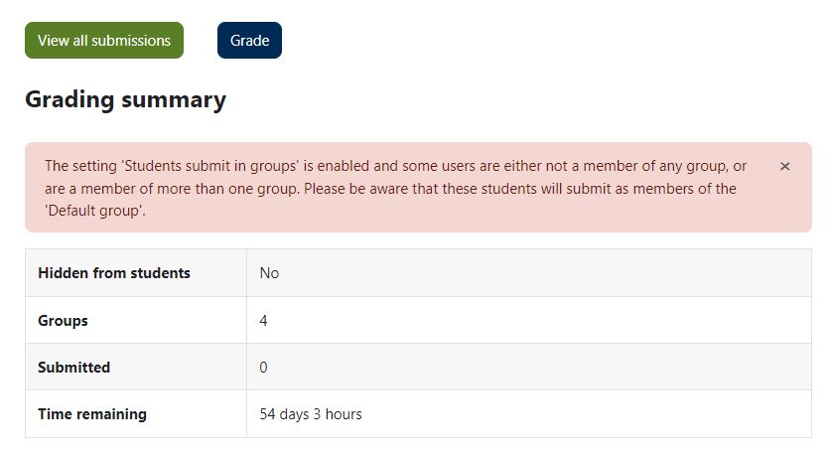
Groups & Groupings top tips – Assignment set-up error
Troubleshooting Groups & Groupings:
Last time I ran a Group Assignment, a student submitted to a Default Group and it caused problems for the group submission
Once you have created your assignment, go to the Assignment submission point and view the Grading Summary and Submissions tab.
Check for any warning (e.g. students are not in a group or are in multiple groups). Check the number of groups and student group allocations.
Adjust group memberships if needed before submissions begin.

Slide 39
Groups & Groupings top tips - Forums
Troubleshooting Groups & Groupings:
I posted a message to students in a group forum. Students say they cannot reply to my post. I want them to be able to reply and discuss within their groups.
When you post to a group forum, and you want students to reply within their groups, you need to choose Advanced and Post a copy to all groups
Your post will appear as a separate post within each group, and students can reply and discuss within groups
If you post to All participants without posting a copy to all groups, all students can see your post, but they cannot reply

Slide 40
Useful Resources
Learning & Teaching Hub
Managing Groups and Groupings guidance
Past events:
Recordings to past CLT workshops and events

Slide 41
Feedback
Thank you for attending today’s session.
Please take a few minutes to fill in our TEL-Bytes webinars: November 2025 – February 2026 feedback form.
Your responses are anonymous.
We will use the feedback to assist in the planning of future webinars and may use comments for future promotional materials.

Slide 42
Closing slide

