Slide 1




Planning for E-portfolios
A structured approach to help you design with confidence
Rachel Applegate,
Learning Technologist (Online learning)
tel@bath.ac.uk
Eliana Catalina Cortes Paez,
Instructional Designer
teachinghub.bath.ac.uk
Notes:
Welcome and introductions
Rachel (Learning Technologist)
University of Bath for 18 years, 15 years in learning technology-related roles
Involved in supporting staff with design and implementation of e-portfolios at scale for around 5 years
E-portfolio assessments and use of Mahara e-portfolio platform increasing over that period
Eliana (Instructional Designer),
Supporting staff with e-portfolio design and implementation, supporting today's session

Slide 2

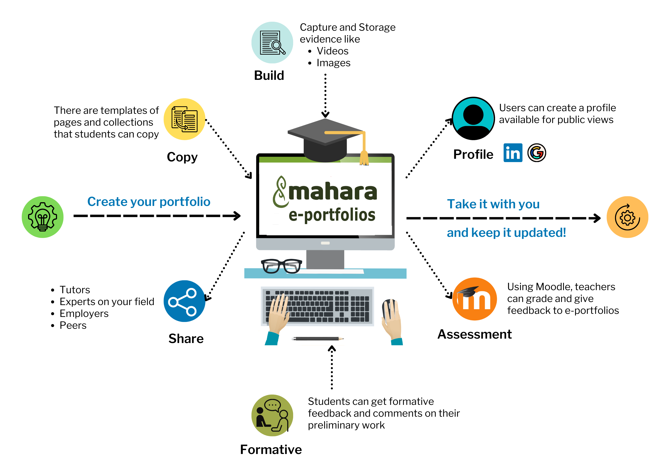



Your experience
Which best describes your level of experience with E-portfolios?
Planting seeds
Beginning to explore and try basic features
Growing Steadily
Using core features in regular work
Producing Results
Confident, effective use across tasks
Thriving Garden
Advanced use, adapting, helping others grow
Quick Teams Poll

Slide 3

Today's session
To recognise key stages in planning for E-portfolio activities and assessments
To identify decisions for planning and implementation, using the principle of constructive alignment
To examine approaches to E-portfolio learning activities and assessment, including how to introduce activities to students and scaffold their learning
To recognise different artefacts and forms of interaction in Mahara, and to discuss their use in different learning contexts
To locate guidance and support when planning for E-portfolios

Slide 4
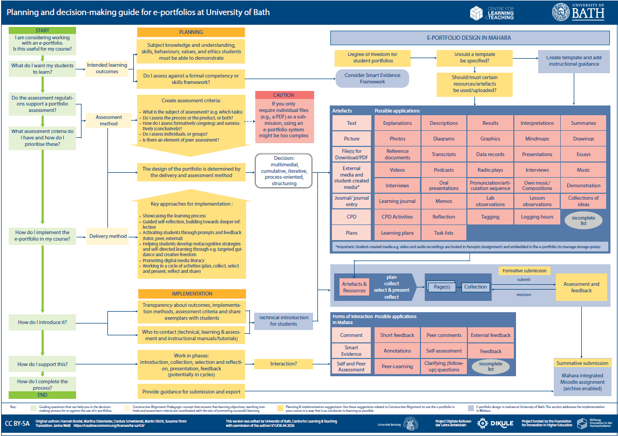
It's all in the planning
Planning and decision-making guide for e-portfolios at University of Bath
View the diagram online
access a PDF version, full-sized image, long image description
In today's session, we will focus in on some key questions

Slide 5
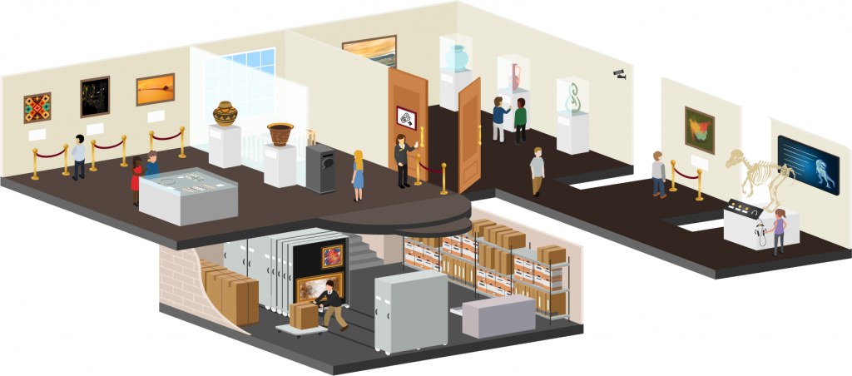
Why a Planning Guide? (1)
Why do we need a Planning Guide?
Learning and assessment with -portfolios is a distinct experience for students.
Staff are often unfamiliar with designing for E-portfolio activities, and with the software
This metaphor (a Museum) is used by Mandia Mentis at Massey University in New Zealand. You can read more in the Mahara manual (25.04)

Slide 6
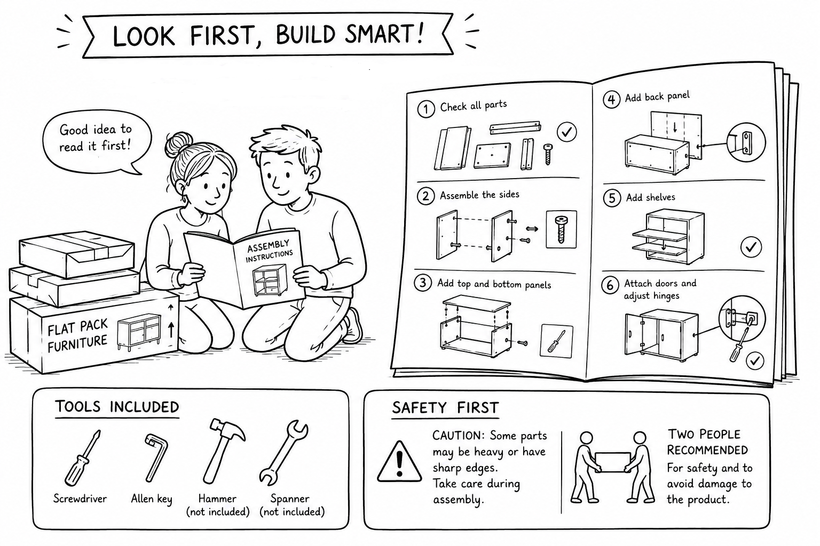
Why a Planning Guide? (2)
Why do we need a Planning Guide?
E-portfolio software is feature rich and flexible – a large toolkit
Before getting started with planning, staff need to
Understand key design decisions
Understand what’s in the toolkit

Slide 7
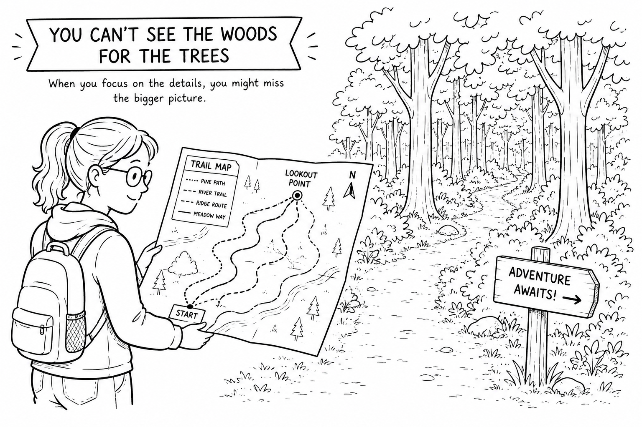
Why a Planning Guide? (2)
Why do we need a Planning Guide?
E-portfolio software is feature rich and flexible – a large toolkit
Before getting started with planning, staff need to
Understand key design decisions
Understand what’s in the toolkit

Slide 8

How would I use the Planning Guide?
To support planning at the early stages
To help you decide if an E-portfolio is the best fit for your activity or assessment
To help make sure you don't miss key decisions
To revisit and improve established activities
  new activity types, templates and induction activities, formative feedback cycles
In conversations with TEL Team
To support conversations with course teams

Slide 9
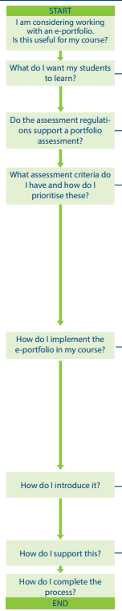
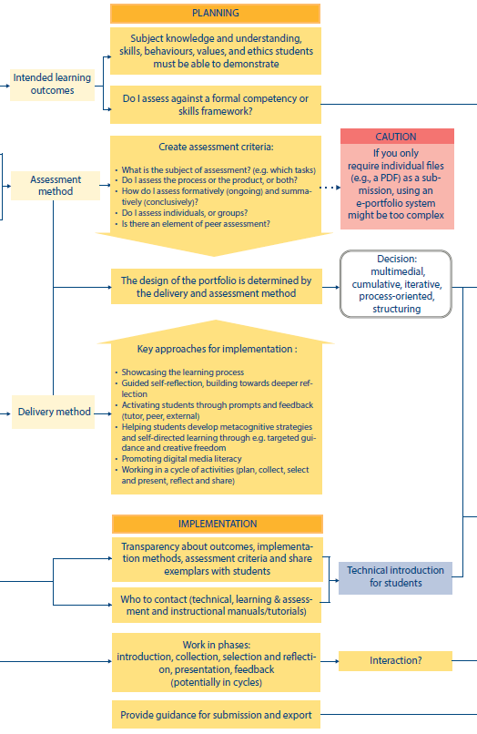
Planning Guide for e-portfolios: guiding questions
Guiding Questions that can help you in the decision-making process for or against the use of e-portfolios.
Constructive alignment
Planning and implementation suggestions:
Use these suggestions to plan for effective e-portfolio use in your course
Notes:
Note: key design decision – do I need an e-portfolio? Is e-portfolio software the most suitable way to support my assessment?
If you have a reflective assessment which required only text-based submissions, other approaches may be more suitable
TEL Team are working with colleagues on new case studies to showcase a range of approaches to supporting Reflective Assessments – case studies and new guidance will be published in the next academic cycle

Slide 10

Discussion activity (1)
Consider a portfolio activity in your learning context
How do I encourage self-reflection, building toward deeper reflection?
How do I help students develop metacognitive strategies and self-directed learning?
How do I promote digital media literacy?
  targeted guidance vs. creative freedom
  Examples, peer review
  prompts and feedback (tutor, peer, external)
10 minutes

Slide 11
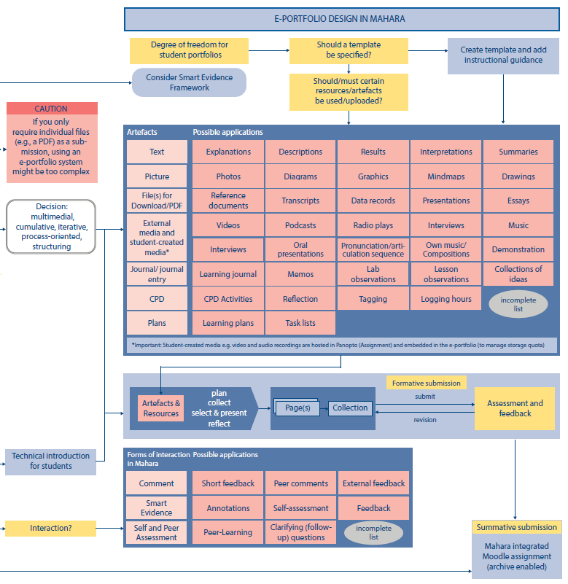
Planning Guide for e-portfolios: e-portfolio design
E-Portfolio design in Mahara: This section addresses implementation in Mahara

Slide 12
Using a template
Key design decision
Should a template be specified?
Example E-portfolios
Portfolio template and example (Universität Würzburg)
MSc Nursing Leena Namburu (DCU)
Should I use a template?
A template is a pre-created page, or collection of pages, that others can copy to use for themselves.
You can create any page or collection and allow it to be copied, acting as a template.
Templates can be a useful timesaver for students. Importantly they provide helpful scaffolding for students when they first start to build an e-portfolio.

Slide 13
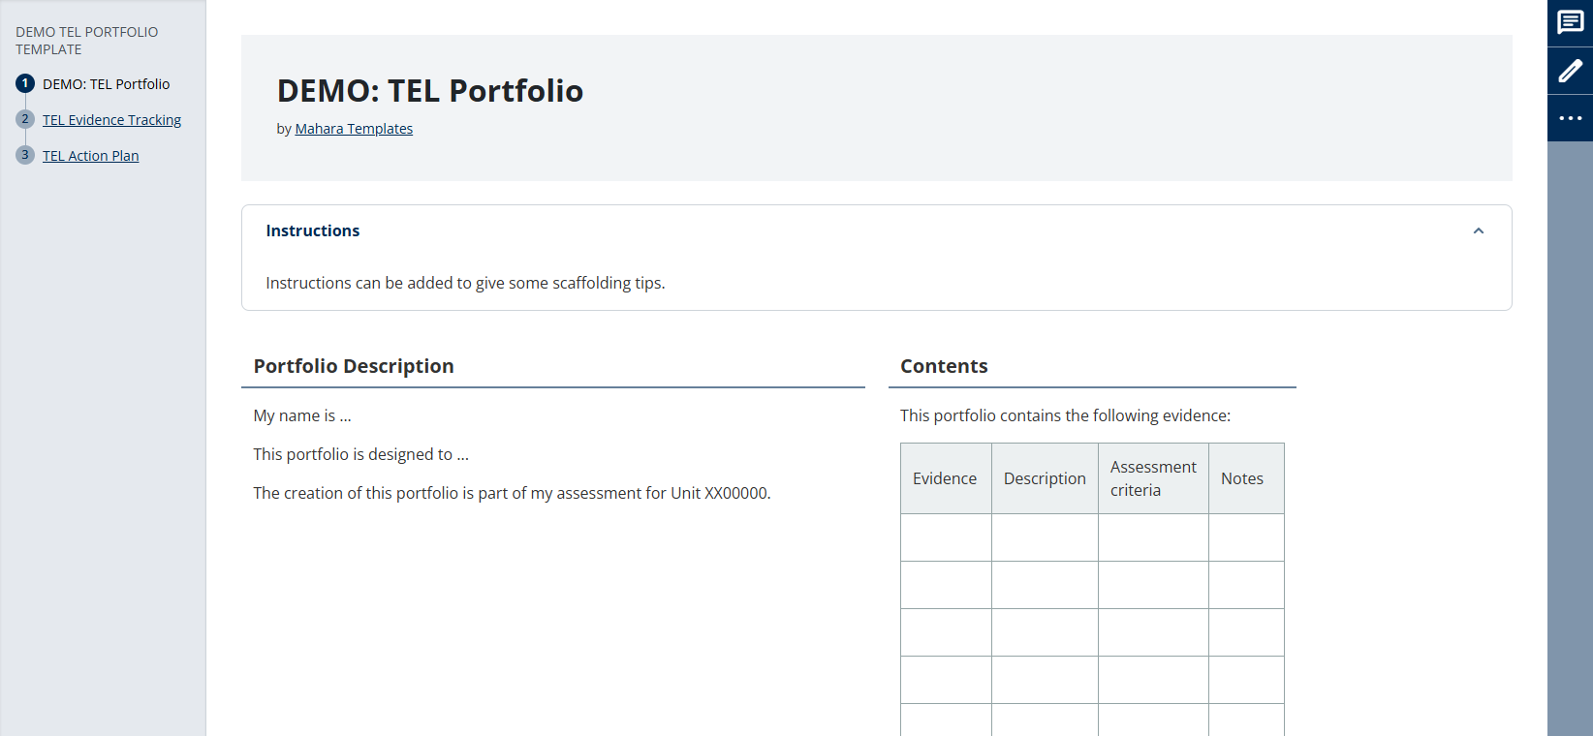
Template example

Slide 14
'Artefacts' and applications
Key design decision
What is the subject of the assessment (which tasks?)
Should / must certain resources or artefacts be used or uploaded?
Multimedia presentation
Text / image
Video (student-created media hosted in Panopto assignment)
Re-useable content
Files
Journals
Plans
CPD
Résumé (CV)

Slide 15
'Artefacts' and applications (2)
Example E-portfolios
MSc in Public Relations & Strategic Comm Mia Iversen (DCU)
Multi-media artefacts (text / image / embedded media)
Employability and Personal development Year 3 student (Southampton Solent University)
Uses Plans & CPD
Examples of E-portfolios (Southampton Solent University)
Examples of E-portfolios (Dublin City University)

Slide 16
Interactions in Mahara
Key design decision
What forms of interaction in Mahara?
To support students working in phases: introduction, collection, selection & reflection, presentation, feedback
Comments
From staff, peers, externals
Formative submission milestones & feedback
Smart Evidence Framework Annotations
Self or peer assessment
Mahara forums (groups)

Slide 17
Smart Evidence Framework
Key design decision
Do I assess against a formal competency or skills framework?
Consider use of Smart Evidence Framework
What is a Smart Evidence Framework?
Using a Smart Evidence Framework in Mahara, staff create a set of criteria or competencies (known as standards).
As they build their portfolio, students map evidence against the standards.
A Smart Evidence framework displays as the first page of their portfolio.
Staff can review completion at a glance

Slide 18
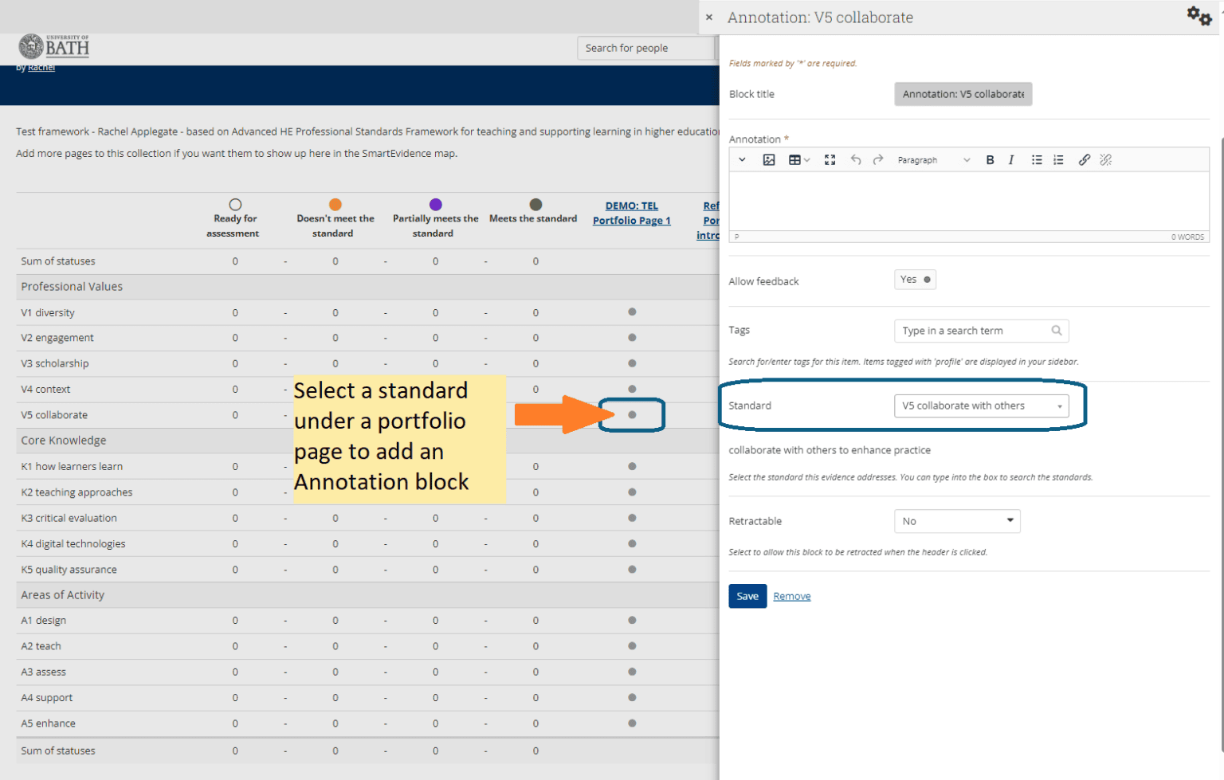
Smart Evidence Framework example

Slide 19
Discussion activity (2)
Consider a portfolio activity in your learning context
In your context, which tasks will you assess (if any)?
Which Mahara artefacts might help your students showcase their learning?
What support might students need?
  Induction activities
  Student guidance
  Templates, Examples
  Formative feedback
10 minutes

Slide 20
Further guidance & support
E-portfolio Planning Guide
  Come and talk to TEL Team
  We can help with planning, designing templates, staff development for wider teams, advice to support student induction
Mahara guidance (Learning & Teaching Hub)
Mahara Basic guide for students
Mahara Demonstration – refreshed user interface (coming September 26)
  Register for our Demo next week (23 June)
  Register for our Demo in September (15 September)

Slide 21
Further resources
Mahara Dev site
  Hosted by Mahara.org
  You can play – it is reset every 24 hours
Donaldson, L. (Ed.). (2021). Exemplars of best practice with Eportfolio based assessment at Dublin City University. NIDL.

Slide 22

What next?
Menti.com - Joining link
Code 6573 3579
How's your confidence with Planning for e-portfolios?
What are your next steps after today's session?

Slide 23
References
Attributions and CC license
Planning and decision-making guide for e-portfolios at University of Bath (V1UOB-04.2026) is a derivative of Planning and decision-making guide for the use of e-portfolios in academic teaching by Hannah Brodel, Martina Osterrieder, Cordula Schwiderski, Martin Sticht, Susanne Timm, Translation Janina Weiß, used under [CC BY-SA 4.0]
University of Bath, Centre for Learning & Teaching has modified this work by changing terminology to reflect UK Higher Education and amending the diagram to reflect Mahara implementation at University of Bath. This derivative work is licensed under [CC BY-SA 4.0] by University of Bath Centre for Learning & Teaching
Use of GenAI
AI systems have been used to create presentation material:
To generate icon style images, Slide 3 (MS Copilot 2026)
To generate ideas for metaphors for professional development growth (MS Copilot 2026)
To generate images to illustrate metaphors, Slides 6-7 (OpenAI ChatGPT-5)

Slide 24



CLT closing slide
Produced by
Centre for Learning & Teaching
in conjunction with
Technology Enhanced Learning Team
2026 - This work is licensed under a Creative Commons Attribution-NonCommercial-NoDerivatives 4.0 International License

